Slide 1

A Post-Hoc Analysis of the Safety Profile of Cariprazine and Potential Relevance for Patient Adherence in Schizophrenia
Free Communication
Ágota Barabássy¹, Zsófia Borbála Dombi¹, Réka Csehi¹, Barbara Sebe¹, István Laszlovszky¹, Balázs Szatmári¹, Bernadett Seregi¹, Károly Acsai¹, Judit Harsányi¹, Anna Burján¹, Arlene Hankinson², György Németh¹
¹Gedeon Richter Plc, Medical Division, Budapest, Hungary
²AbbVie, Medical Safety, Madison, NJ, United States
WFSBP 2021 Virtual

Slide 2
Conflict of Interest
Ágota Barabássy is an employee at Gedeon Richter Plc.

Slide 3

The importance of treatment adherence in schizophrenia
Adherence is the extent to which a person's behaviour (taking medication, following a diet, and/or executing lifestyle changes) corresponds with the agreed recommendations from a healthcare provider.¹
26.5 – 68.8%
of schizophrenia patients are non-adherent^{2,3}
Non-adherent patients are 10 times more likely to have a psychotic relapse⁴
Non-adherent patients are 4 times more likely to be admitted to hospital⁴
References: 1. WHO (2003) Adherence To Long-term Therapies: Evidence For Action 2. Eticha et al. (2015) PLoS ONE 10(3): e0120560. 3. Sultan et al. (2016) Middle East Curr. Psychiatry 23 (1), 27–34 4. Higashi et al. (2013). Therapeutic advances in psychopharmacology, 3(4), 200–218.

Slide 4









Risk factors for non-adherence
Nonadherence to medication includes a range of patient behaviours, from treatment refusal to irregular use or partial change of daily medication doses.¹
Factors associated with nonadherence
Poor insight²
[55.6%]
Substance abuse²
[36.1%]
Negative attitude²
[30.5%]
Side effects²
[27.8%]
Cognitive impairments² [13.4%]
Younger age³
Relapse⁴
Medication beliefs¹
Low socioeconomic status⁵
References: 1. Higashi et al. (2013). Therapeutic advances in psychopharmacology, 3(4), 200–218. 2. Velligan et al. (2017 Patient preference and adherence, 11, 449–468. 3. Lang et al. (2010) Psychiatr. Serv. 61 (12), 1239–1247. 4. Hui et al. (2016) Schizophr. Res. 174 (1–3), 144–149. 5. Ahmad et al. (2017) Asian J. Psychiatr. 30, 39–43.

Slide 5
Side effects and non-adherence
Side effects are often viewed as being worse than the positive symptoms of psychosis by patients and a group of them tend to stop taking their medication after being discharged from the hospital.¹
Side effects either „extremely” or „very” bothersome³
27%
of patients think APs do more harm than good³
Weight gain
Sexual dysfunction
Trouble concentrating
56%
86 – 98%
of patients report experiencing side effects^{2,3}
All significantly related with lower rates of
adherence²
55%
54%
References: 1. Salzmann-Erikson M, Sjödin M. (2018) Int J Nurs Stud. 85:7-18 2. Dibonaventura et al. (2012) BMC Psychiatry;12:20. 3. Doane et al. (2020). Patient preference and adherence, 14, 2043–2054.

Slide 6
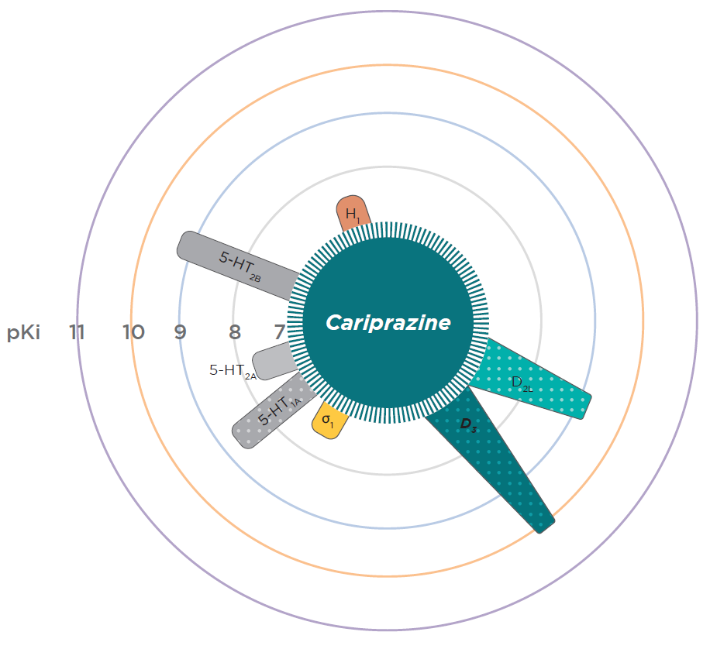
Cariprazine, a novel antipsychotic medication
Cariprazine is a novel antipsychotic medication with potent dopamine D3-D2 partial agonism and preferential binding to the D3 receptors.¹
High affinity
Dopamine D₃ Partial agonist
Dopamine D₂ Partial agonist
Serotonin 5-HT_{2B} Antagonist
Serotonin 5-HT_{1A} Partial agonist
Moderate affinity
Serotonin 5-HT_{2A} Antagonist
Histamine H₁ Antagonist
Serotonin 5-HT_{2C} Antagonist
Adrenergic α₁ Antagonist
Low, or no affinity
Dopamine D₁ & D₄ Antagonist
Adrenergic α₂ Antagonist
Muscarinic M₁ Antagonist
References: 1. Kiss. J Pharmacol Exp Ther 2010.333:328–340; Partial agonism is represented with dots, circles show pKi values.

Slide 7
Cariprazine clinical development
The clinical development program of cariprazine included 42 studies; numerous PK studies, 8 schizophrenia studies, 4 mania studies, 4 BD and 4 MDD studies.
Schizophrenia |  | Mania |  | Bipolar depression |  | Major depression
RGH-MD-03 | 2 | RGH-MD-31 | 2 | RGH-MD-52 | 2 | RGH-MD-71 | 2
RGH-MD-16 | 2b | RGH-MD-32 | 3 | RGH-MD-53 | 3 | RGH-MD-72 | 3
RGH-MD-04 | 3 | RGH-MD-33 | 3 | RGH-MD-54 | 3 | RGH-MD-75 | 2b
RGH-MD-05 | 3 | RGH-MD-36 | safety | RGH-MD-56 | 2b | RGH-MD-76 | safety
RGH-MD-06 | 3
RGH-188-005 | 3
RGH-MD-11 | safety
RGH-MD-17 | safety

Slide 8



Aim & Methods
Data
Patient population
Adverse events
4 short-term, randomized, 6-week double-blind, placebo-controlled studies
4 long-term, 48-week open- label, flexible-dose safety studies
Adult schizophrenia patients (18-65 years) according to DSM-IV
Current exacerbation of symptoms
Adverse event (AE) recordings, clinical laboratory tests, vital sign parameters, weight changes, and electrocardiograms (ECGs)
The aim of the present analysis was to understand the safety profile of cariprazine from the perspective to medication adherence.

Slide 9
Demographics
Data from 2048 cariprazine-treated and 683 placebo-treated patients were analyzed.¹
37.8
Age, mean
38.2
71.0
Sex, male (%)
68.8
CARIPRAZINE TOTAL
1.5-6.0 mg
PLACEBO
N = 683
77.5
Weight, mean (kg)
77.5
N = 2048
12.6
Duration of schizophrenia (years)
12.4
Age at onset of original diagnosis of schizophrenia (years)
25.2
25.6
References: 1. Barabássy Á, Sebe B, Acsai K, Laszlovszky I, Szatmári B, Earley WR, Németh G2021 Apr 7;17:957-970. doi: 10.2147/NDT.S301225. Erratum in: Neuropsychiatr Dis Treat. 2021 May 17;17:1481. PMID: 33854317; PMCID: PMC8040316

Slide 10
Discontinuation
52.8% of cariprazine-treated patients completed the studies, while this number was 51.2% in the placebo arm.¹
Most common reasons for discontinuation
CAR 433 (21.1)
PBO 74 (10.8)
CAR 251 (12.3)
PBO 76 (11.1)
CAR 162 (7.9)
PBO 100 (14.6)
Withdrawal of consent
Adverse
event
Insufficient therapeutic response
References: 1. Barabássy Á, Sebe B, Acsai K, Laszlovszky I, Szatmári B, Earley WR, Németh G2021 Apr 7;17:957-970. doi: 10.2147/NDT.S301225. Erratum in: Neuropsychiatr Dis Treat. 2021 May 17;17:1481. PMID: 33854317; PMCID: PMC8040316

Slide 11
Cariprazine may promote adherence
74% of cariprazine-treated patients experienced at least one TEAE vs 63% of placebo-treated patients.
3.1%
Sedation
3.7%
0.1%
Prolactin elevation
0%
CARIPRAZINE TOTAL
1.5-6.0 mg
PLACEBO
PLACEBO
0.3%
Cognition impairment
0.5%
CARIPRAZINE
0.3%
Sexual dysfunction
1.0%
1.5%
Weight increased
5.1%
SMPC: In the long term maintenance of effect study, there was no clinically relevant difference in change of body weight from baseline to end of treatment
(1.1 kg for cariprazine and 0.9 kg for placebo).

Slide 12
Conclusions
Adherence to antipsychotic medication is important as patients who stop taking their medication are more likely to relapse and be admitted to the hospital.
One of the main risk factors for nonadherence are medication side effects, that are often being perceived to be worse than the symptoms themselves. In particular, weight gain, sexual dysfunction and concentration difficulties are extremely bothersome for patients.
In this pooled safety analysis using data from all the studies included in the clinical development program in schizophrenia, cariprazine was safe and generally well tolerated in patients with acute and long-term exposure in the recommended dose range.
Discontinuation rate due to side effects was similar to placebo, and TEAEs that are most relevant for patients and are likely to result in nonadherence were low.

Slide 13
Thank you for your attention!

